Slide 1
Set Fire to Xamarin
with Firebase
VINOD SRINIVASAN
21st March 2018

Slide 2
Important
AIM:
The aim of this presentation is to educate the features provided by Google Firebase and how we could integrate with Xamarin.
DISCLAIMER:
I am not affiliated with either Xamarin and or Google Firebase. This presentation is not endorsed by either Google Firebase or by Xamarin Microsoft. I accept no liability for any decisions made based on this presentation. Please seek advice from the official bodies (Firebase and Microsoft) before implementing any of these suggestions / recommendation in a Production environment.
The content provided here based on the information obtained from
https://firebase.google.com/
Most of the comments made or provided are based on my personal experience experimenting with Google Firebase suite of products and is not intended to promote or to damage the reputation of the product/ features of Google Firebase.

Slide 3
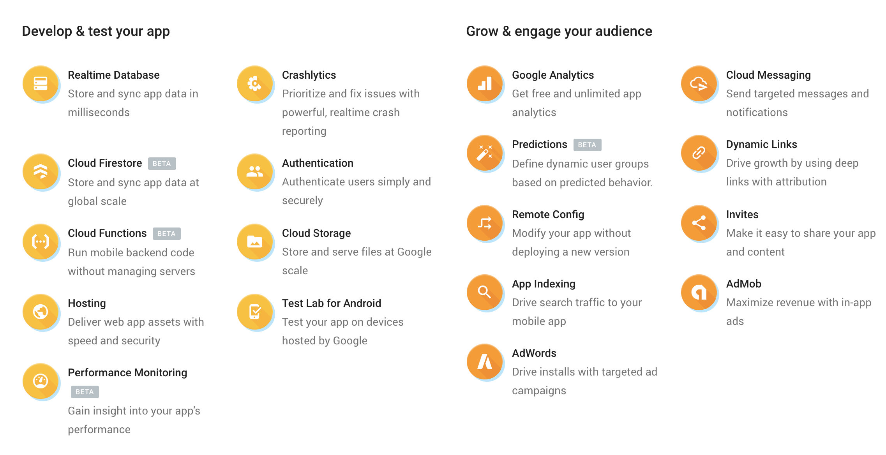
What is Firebase?
Firebase is a mobile and web application development platform developed by Firebase, Inc. in 2011, then acquired by Google in 2014.
“Firebase helps you develop high-quality apps, grow your user base, and earn more money. Each feature works independently, and they work even better together.”

Slide 4
Why Firebase?
Develop high quality apps
Grow your user base & earn more money.
Affordable cost
Firebase classifies its products into two categories:
Develop & Test
Beneficial for the Development team
Grow & Earn
Beneficial for the Product management team

Slide 5
Firebase Product Suite
Develop & Test
Realtime Database
Authentication
Test Lab for Android
Crashlytics
Hosting
Cloud Firestore
Cloud Storage
Performance monitoring
Cloud Functions
Notes:
Realtime DB:
No SQL Database that helps to store and sync data between devices ,available even in offline mode, with stronger security. Ideal for DB which does not require global scaling
Serverless with Cloud Functions
Authentication:
Comprehensive security with fast implementation. Integrates well with other Firebase features such as Realtime DB, Functions etc.
Test Lab:
Test your labs on real android devices hosted by Google. Set up CI to achieve this and get detailed reports including the video recordings.
Robo crawls through the app and collects crash reports and generates reports. Ameican Express is a testimony to this.
Crashlytics:
Get realtime crash reporting categorised into issues. Doodle has benefitted from this.
Hosting:
Deliver web content faster either it is a single page or even a progressive web page. SSD backed and you get free SSL cert. Well you get it with Let’s Encrypt anyway.
Cloud Firestore:
NoSQL DB with offline sync between devices. More like the Realtime DB but can scale globally
Difference between Realtime DB and FireStore
https://firebase.googleblog.com/2017/10/cloud-firestore-for-rtdb-developers.html
Cloud Storage:
For stroing files and videos. More like the blob storage. With tighter security when combined with Auth.
Performance monitoring:
Monitor performance of your app from the user’s perspective with automated and default traces. Provides insights into network latency.
Cloud Functions:
More like Azure functions. Serverless backend. Integrates well with DB and FireStore.

Slide 6
Firebase Product Suite
Grow & Earn
Analytics
Invites
Cloud Messaging
Predictions
AdMob
Dynamic Links
AdWords
Remote Config
App Indexing
Notes:
Google Analytics
User insights from acquisiton to usage. Works well with Invites and Dynamic Links giving you insights on how many conversions were made.
Invites
Out of the box solution for App referrals and sharing via SMS and email.
Cloud Messaging
Built on top of GCM for sending notifications to the user’s device
Predictions
You can increase your revenue and retention based on Google’s machine learning. Send notifications to prevent user groups likely to uninstall the app or to reward the ones who churned in.
AdMob
AdMob increases the monitisation of your app by dispaying targeted adds in your app. You will need an AdMob account and define an AdMob Unit ID to integrate.
Dynamic Links:
Have deep links that survive the app installation. We will see this in the demo.
AdWords
Drive more installations, gain insights into how your ad word investment is paying off. Run targeted ad campaigns using Google analytics for Firebase audience. An import and export data into Analytics for better reporting purposes. You need Ad Words account and link it to Firebase and must have Analytics turned ON.
Remote Config
Make changes to your app without releasing new versions e.g. Change Themes, provide differnet User metrics based on the country etc.
App Indexing
Re-engage the users with Google Search auto completion and the Search page to list your app based on the content provided in the app.
James Montemagno has explained how you can achieve this in your Xamarin Android app in his blog
https://blog.xamarin.com/connect-with-your-users-with-google-search-and-app-indexing/

Slide 7
Firebase Pricing
Firebase provides 3 tiers of pricing plans
Spark (Free)
Flame (USD $25 per month)
Blaze (Pay as you go)
Realtime Database, Storage, functions, Hosting, Test Lab, and phone authentication are the paid infrastructure products but the free tier Spark offers these as well (with capped limits).
Almost all the other products are free products and available in all 3 pricing tiers.
Source: https://firebase.google.com/pricing/ (correct as of 18th March 2018)

Slide 8
Firebase by Platform
The officially supported platforms are:
iOS API Reference
Android API Reference
Web API Reference
C++ API Reference
Unity API Reference
Source:
https://firebase.google.com/docs/

Slide 9
Firebase for Xamarin?
But what about support for Xamarin ?
Nuget to the rescue.
Xamarin Microsoft are actively releasing the binding libraries for the Firebase APIS that are available on the Nuget store.
iOS:
https://www.nuget.org/packages?q=Xamarin.Firebase.iOS
Android:
https://www.nuget.org/packages?q=Xamarin.Firebase

Slide 10
Firebase Xamarin Support
Develop & Test | Xamarin Android | Xamarin iOS
Realtime Database
Auth
Crash |  | ?
Storage
FireStore |  | ?
Performance
Grow & Earn | Xamarin Android | Xamarin iOS
Analytics
Invites
Cloud Messaging
Dynamic Links
Remote Config
App Indexing

Slide 11
DEEP DIVE
Grow & Earn
Dynamic Links
Convert Web and Desktop users into your App users without losing end-user
Engagement.
Develop & Test
Firebase Authentication
Fabulous, Rave, reebee, Kwaver Music are some of the real-world solutions which integrated with Firebase Authentication little dev effort.

Slide 12
Firebase Authentication
Supports industry standards like OAuth 2 and Open ID Connect
Methods of Authentication
Conventional Email + Password Authentication
Federated Identity using one or all of
Google
Facebook
Twitter
GitHub
Password-less Authentication (SMS)
Custom Authentication (Bring your own ID Provider)
Anonymous Authentication

Slide 13
Dynamic Links
Convert the web users into app users with this amazing feature.
Set up your app in Firebase Console
Create dynamic links (manual | programmatic)
Integrate with iOS and Android for these links
Special things to do for iOS
Gotchas
Integration into Analytics for Free.

Slide 14
DEMO

Slide 15
QUESTIONS?

Slide 16
THANK YOU

